Slide 1


Slide 2

The Leading Provider of Financial Services to Middle-Income Families with 130,000+ licensed Representatives
Listed on the New York Stock Exchange (PRI)
In business since 1977
Over 5.5 million lives insured and approximately 2.6 million investment clients
As of December 31, 2020
Primerica representatives market term life insurance underwritten by National Benefit Life Insurance Company (Home Office: Long Island City, NY) in New York and Primerica Life Insurance Company (Executive Offices: Duluth, GA) in all other U.S. jurisdictions. In the U.S., securities are offered through PFS Investments Inc., 1 Primerica Parkway, Duluth, Georgia 30099-0001. PFS Investments Inc. is a member of FINRA and SIPC.

Slide 3
Our Mission Statement
To help families earn more income and become properly protected,
debt free and financially independent.
Notes:
So our mission is to help families and this is what we would be teaching you how to do, help families earn more income, show them how to become property protected, debt free and become financially independent. Wouldn't you agree that's most people's goal in life?
-click-

Slide 4

20 YEARS
IN A ROW

Slide 5
3 REASONS WHY WE ARE HERE
TRAINING CERTIFICATION
POTENTIAL CLIENT
EXPANSION

Slide 6

5 Reasons why people get involved with our company
1
2
3
4
5
1
2
3
4
5
DISLIKE CURRENT JOB
EARN EXTRA INCOME
FINANCIAL EDUCATION
LOVE HELPING PEOPLE
DESIRE TO OWN A BUSINESS
You’re looking for a career change with better income potential.
You love what you do, but a part-time income would make a difference.
You want to learn how to win the money game.
You believe in making a difference and helping others.
You dream of having your own business.
Can you see where most people would be interested in at least one of these areas?

Slide 7
Not all products and services are available in all states, territories, or the District of Columbia. A representative's ability to offer products from the companies listed is subject to state and federal licensing and certification requirements. Please refer to the Important Endnotes for additional details about the contractual arrangements and company affiliations detailed above.

Slide 8

Financial Challenges
Seventy-four percent of workers report living paycheck to paycheck. MarketWatch.com, “A Shocking Number of Americans Are Living Paycheck to Paycheck,” January 11, 2020
Almost half of Americans say they worry they’ll run out of money in retirement. Forbes.com, “Top 4 Retirement Worries – and How to Handle Them,” September 24, 2020
The average American has $90,460 in total consumer debt. CNBC.com, “The Average American has $90,460 in Debt – Here’s How Much Debt Americans Have at Every Age,” January 22, 2021
About 60 million households in the U.S. are underinsured or uninsured Forbes.com, “How Much Life Insurance Do You Really Need?” January 13, 2020
Nearly 30% of Americans say they have less than $25,000 in savings and investments put away for retirement. EBRI.org, Employee Benefit Research Institute 2021 Retirement Confidence Survey

Slide 9

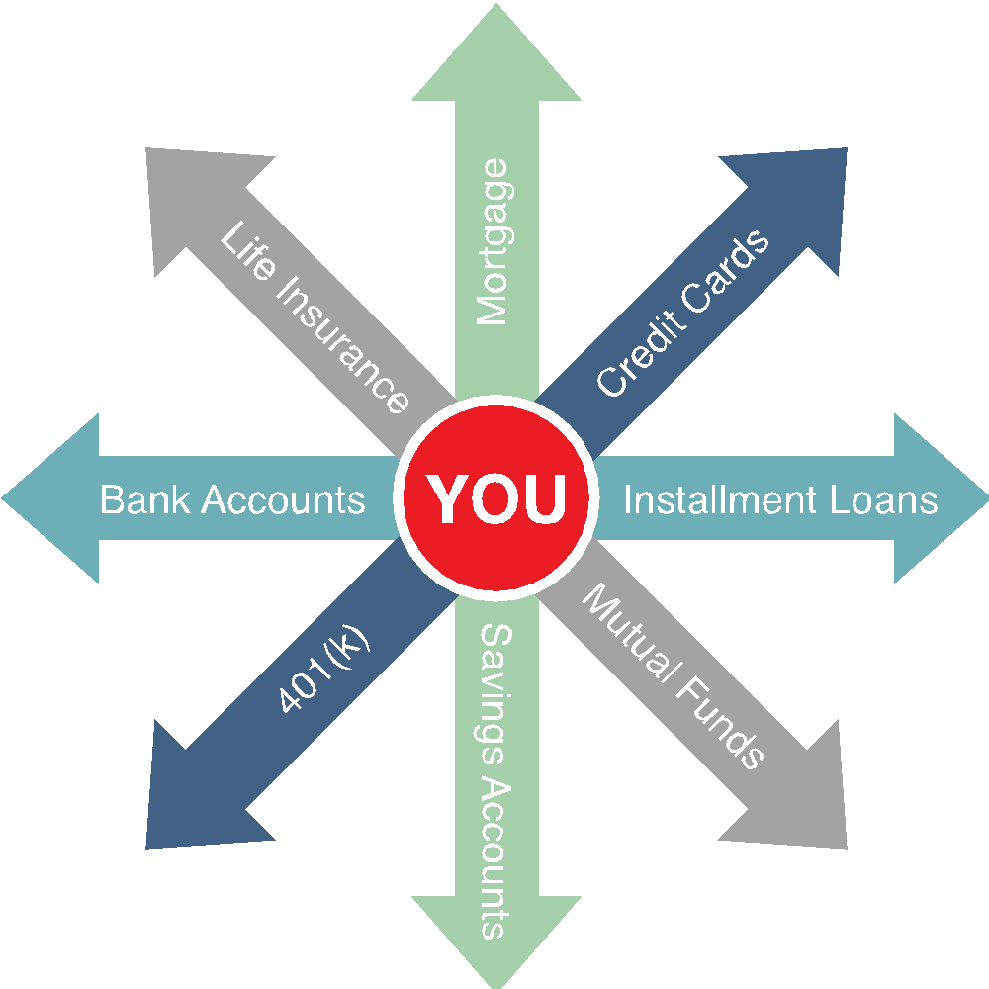
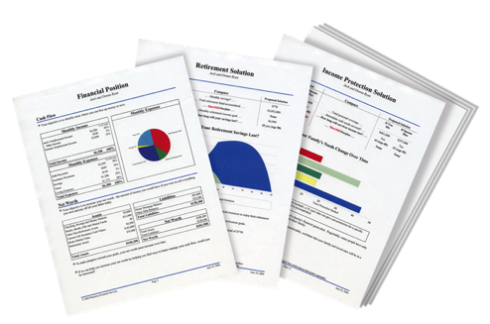

People Don’t Plan to Fail, They Fail to Plan
The Problem:
Traditional financial institutions sell you products. They don’t provide you with a total solution.
The Solution:
A Financial Needs Analysis. A customized, confidential and complimentary program that helps you achieve your goals and dreams.
A Financial GPS: It helps you find answers to important questions.

Slide 10
RULE OF 72
72 / 4% = 18 YEARS
72 / 12% = 6 YEARS
DETERMINES HOW LONG IT TAKES FOR YOUR MONEY TO DOUBLE
72 / INTEREST RATE = YEARS
72 / 1% = 72 YEARS
NEVER!

Slide 11


RULE OF 72​
DETERMINES HOW LONG IT TAKES FOR YOUR MONEY TO DOUBLE​
72 / INTEREST RATE = YEARS​
$200
SHOE BOX
BANK
MUTUAL FUNDS
YEARS
0%
2%
12%
(Avg.)
10
$24,000
$26,592
$23,195
15
$36,000
$42,013
$50,373
20
$48,000
$59,185
$99,958
30
$72,000
$99,170
$352,728
35
$84,000
$121,687
$650,342

Slide 12



$2,500
$2,500
MONTHLY INCOME
MONTHLY INCOME
Income Protection
Mortgage
Cars
Insurance
Credit Cards
Utilities
Groceries
Child Care
$4,000
MONTHLY BILLS
$250,000
$250,000
COVERAGE
COVERAGE
$25,000
COVERAGE

Slide 13
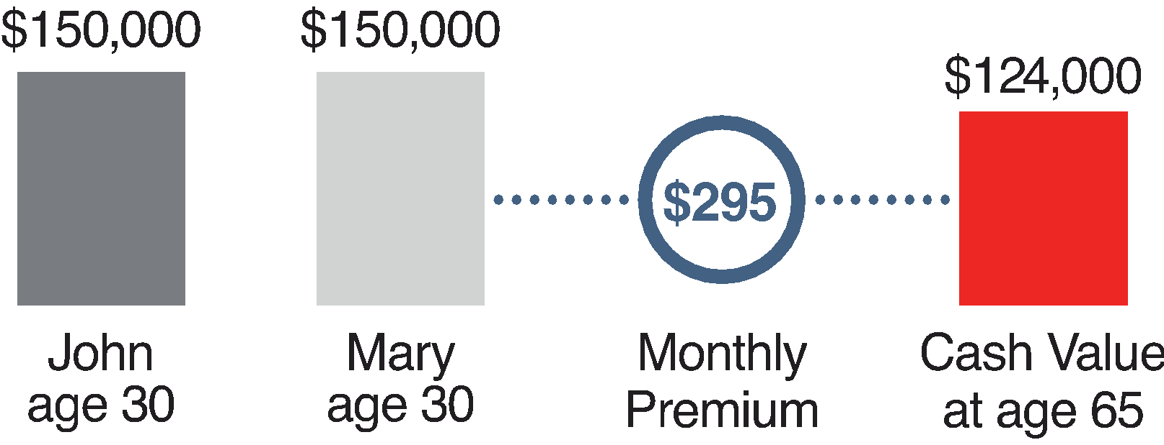
Life Insurance: What Is the Difference?
Cash Value Life Insurance Whole Life, Universal Life
Buy Term and Invest the Difference 35-year Level Term, $10,000 each on two children
Same
$295
0-4 years no money in saving
Borrow your own money
Most keep Cash Value when you die
$400,000
$400,000
$169 @ 9%
SAVINGS
$500,890
$126
John
age 30
Mary
age 30
Monthly
Premium
Cash Value
at age 65
Monthly premium for cash value policies is an average of whole life policies from three major North American life insurance companies for male and female, both age 30 and standard risk. Cash value life insurance can be universal life, whole life or variable life, and may contain benefits in addition to a death benefit, such as dividends, interest, or cash value available for a loan or upon surrender of the policy. Whole life usually has a level premium for the life of the policy. Term insurance provides a death benefit only and its premiums increase at certain ages.
For remaining assumptions, please refer to end notes.
Not for use in New York.

Slide 14

FINANCIAL GAME PLAN
RENTING
WEALTH
ESTABLISHED
WEALTH
PRIMARY
$300,000
$300 x 12
MONTHS
$3,600
THEORY OF DECREASING RESPONSIBILTY
SPOUSE
COVERAGE
$3,600 x 30
$108,000
$300,000
YEARS
$452,097
CHILDREN
COVERAGE
ROTH IRA TAX FREE @59 1/2
$452,097
$10,000
HOW LIFE WORKS
INSTANT PROTECTION
COVERAGE
$100
IN THE EARLIER YEARS, PROTECTION IS A MUST
IN THE LATER YEARS, RETIREMENT INCOME IS A MUST
TODAY
35/32
RETIREMENT
65/62
AGE
AGE
$300
HOUSE MORTGAGE
CHILDREN GROWN
HIGH DEBT
LOWER DEBT
MONTHLY
INVESTMENT
YOUNG CHILDREN
MORTGAGE PAID
LOSS OF INCOME WOULD BE DEVASTATING
RETIREMENT INCOME IS NEEDED
YOU’RE NOW SELF INSURED
$200
IN THE EARLIER YEARS, YOU MAY NOT HAVE MONEY
IN THE LATER YEARS, YOU MAY NOT.
MUTUAL FUND

Slide 15
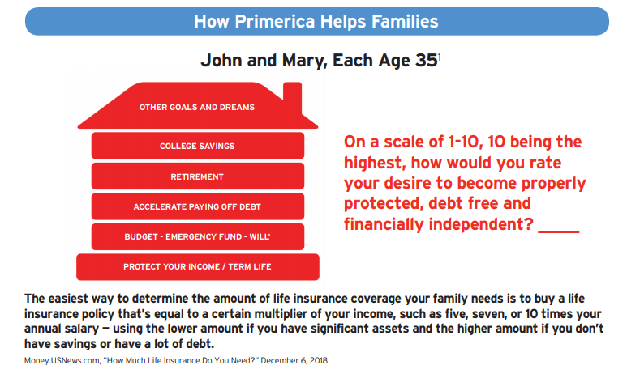

Slide 16

THE SOLUTION
On a scale of 1-10, 10 being the highest, how would you rate your desire to become properly protected, debt free and financially independent? ___
A good rule of thumb is to purchase life insurance coverage between seven and 15 times your annual salary. You'll also want to take into account your financial goals, education costs, debt, etc., when determining the coverage the coverage amount that works for your needs.
Forbes.com, "How Much Life Inurance Do You Really Need?" January 13,2020
Will is availble through the Primerica Legal Protection Program. Exclusions and limitations apply. See plan for your state for details.

Slide 17
LET ME SHOW YOU HOW WE GET PAID
THE TABLE BELOW SHOWS THE ESTIMATED COMMISSIONS BY LEVEL BASED ON THE PRODUCTS SELECTED 75% ADVANCEMENT
YOU Train ME…&
TEACH ME HOW TO GET MY INSURANCE LICENSE
LEVEL
PERSONAL
REP 25%
SPARE TIME
$250
$500
DIS 50%
PART TIME
$500
$1,100
I MAKE
$500
$600
RVP 110%
FULL TIME
$1,100
YOU MAKE

Slide 18
PART TIME V.S CAREER CHANGE
PART TIME
FULL TIME LEADER
Obtain your State and Federal licenses.
Earn a great potential income per month, part time.
Help families as a financial coach.
Have a very flexible schedule. Work when you want.
Create your client base through our warm market and social media referral system.
Become fully licensed as a Regional Vice President with your own individually owned office, with no territory restrictions.
License 8-10 individuals and teach them how to do the same.(RVP)
Work to build your income to $100,000, and when you reach $300,000 you qualify for Full Ownership.
Primerica Representatives are independent contractors and are not employees of Primerica. Representatives earn income through the sale of products and are not paid to recruit.
From January 1 through December 31, 2020, Primerica paid cash flow to its North American sales force at an average of $7,198, which includes commissions paid on all lines of business to licensed representatives. Figures include U.S. and Canadian dollars remaining in the local currency earned by the representative, not adjusted for exchange rates. Actual gross cash flow is, among other factors, dependent upon the size and scale of a representative’s organization, the number of sales and the override spread on each sale, and the ability and efforts of a representative and their downlines.
Primerica Representatives are independent contractors and are not employees of Primerica. Ownership is available only upon meeting all qualification and eligibility requirements, and remaining in compliance with all terms and conditions, as set forth in the Ownership Program Document and various operating policies and procedures issued by Primerica from
Notes:
Usually people start off part-time. We would get you state and federal licensing. You would get an insurance license, investment and mortgage loan officer license. You would earn a great potential income per month part-time, help families as a financial coach and have a flexible schedule so it doesn't have to jeopardize anything you have going on and we would also teach you how to create a client base either through warm market, social media and referral system that we’ll train you on.
-click- Then there's full-time leader which if you get your life insurance and investment license you can become a regional vice president here and if you get about 8 to 10 people trained you'll be making about $100,000 a year as a regional vice president but there is no cap to your income here and once you reach $300,000 a year in income you get complete ownership of your business so let's just say you decide to walk away from Primerica at that point you can either sell it back to the company for 10 times more the amount of what it's worth or you can pass it down to a family member and it can become a legacy that you leave behind for generations to generations..
-click-

Slide 19
What Interest You The Most?
PRODUCTS & SERVICES
PART TIME OR FULL TIME OPPORTUNITY
OR BOTH

Slide 20




Independent Business Application (IBA)
The Ultimate Business Support System
$25
$99
MONTH
ONE TIME INVESTMENT OF
$124
Application Value Includes:
State Application
Exam Fee
Processing Fees
Appointment Fee
Fingerprint
Typical Cost to Becoming Fully Licensed Approximately $4,500
Technology Support Package Value Includes:
Cell phone discount: up to 25%/yr.
Your own website and business reports: $50/mo.
Live and on-demand video training: $55/mo.
Total Value: $105+/month
Additional Potential Value Includes:
Exam Fee: $450
Exam Prep Course: $150 to $200
Securities License Total: Approximately $1,000*
Software $625/mo.**
RECEIVE $50 BACK ONCE YOU PASS LIFE INS EXAM

Slide 21


